Slide 1
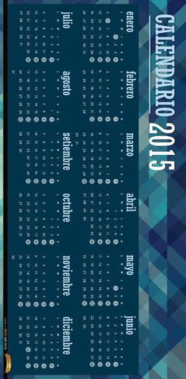
SMART CALENDER
Nysha Katiyar
23FE10CII00031

Slide 2
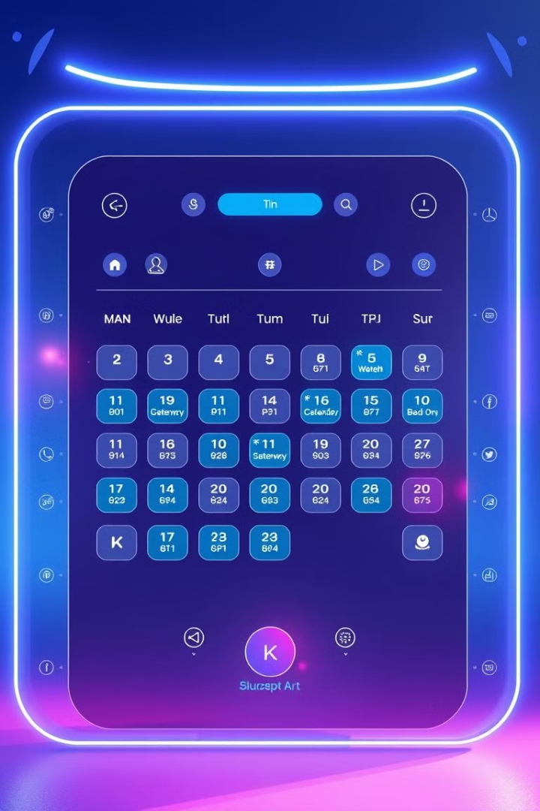
Smart Calendar: Revolutionizing Scheduling with IoT and AI
Smart Calendar Integration with IoT allows users to manage tasks and schedules efficiently by integrating IoT devices (like smart speakers, notifications, etc.) with Google Calendar or similar services. We can implement this project in several ways using cloud platforms and APIs without much hardware.

Slide 3
The Problem: Why Traditional Calendars Fall Short
Limited Automation
Lack of Integration
No Smart Assistance
Traditional calendars lack automated scheduling features.
They don't seamlessly integrate with other IoT devices.
They offer minimal AI-driven task management.

Slide 4
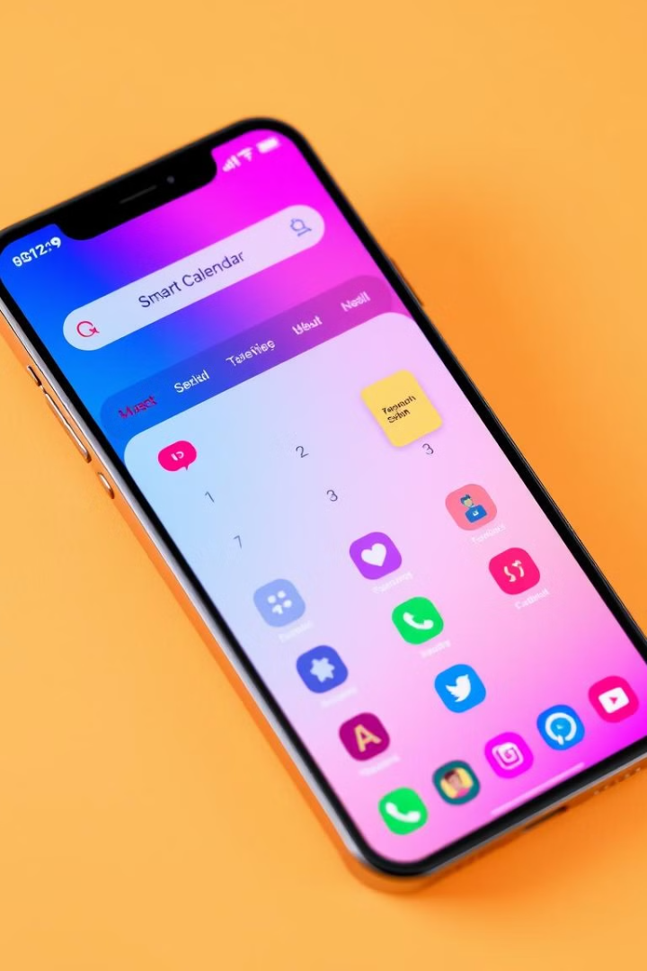
What is a Smart Calendar? Defining the Concept
1
IoT-Enabled
2
AI-Powered
Connects with devices for automated scheduling.
Uses machine learning for smart task management.
3
Cloud-Based
Stores and syncs data across platforms.

Slide 5
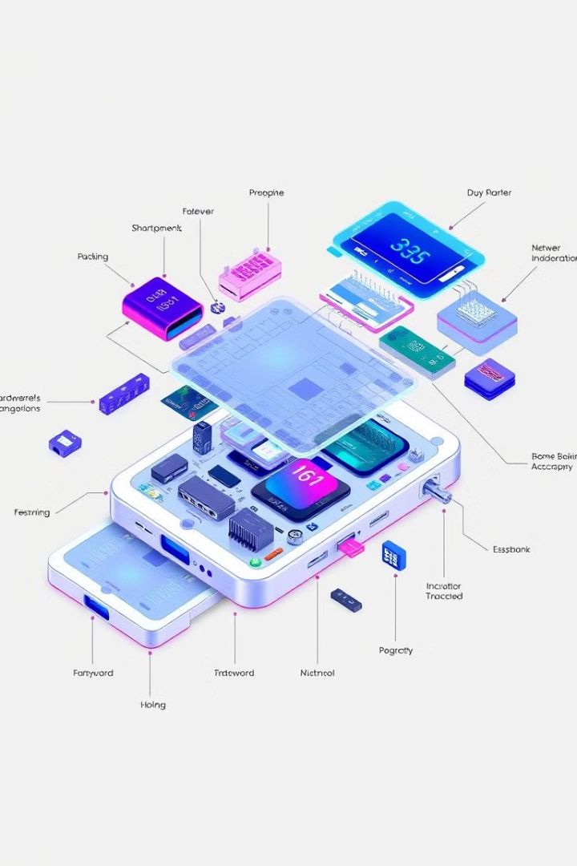



Key Components: Hardware, Software, and Connectivity
Hardware
Software
Connectivity
Devices for data collection.
Algorithms for data analysis and scheduling.
Networks for seamless data transfer.

Slide 6
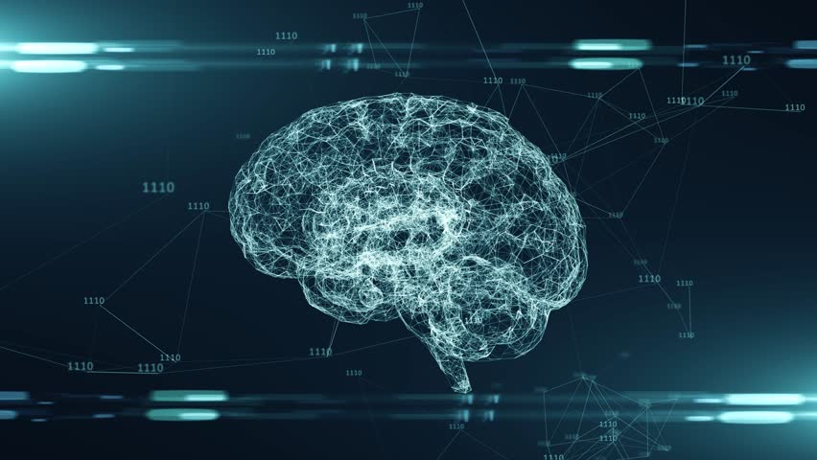
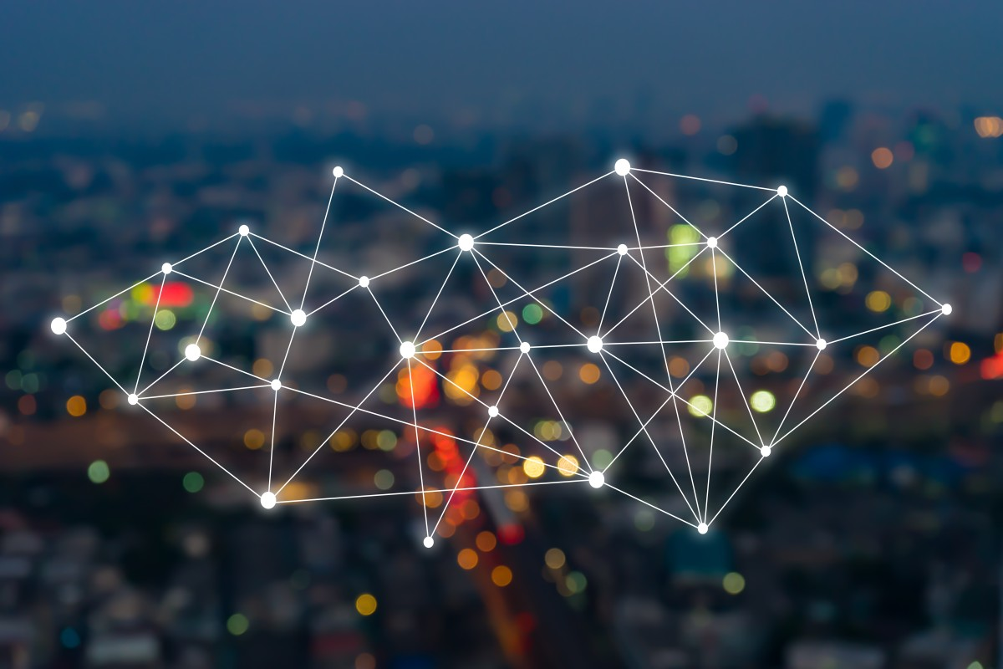
Key Components:
2. Backend (Server-Side Logic)
The backend handles the processing, scheduling, and storing of calendar events.
Event Processing Engine
Handles event creation, modification, and deletion.
Schedules reminders and notifications.
Database (Event Storage):
Stores event details like:
Event title, date, time
Recurring events
Priority level
Examples: Firebase, MySQL, MongoDB.
Authentication Module
Handles user logins and permissions using OAuth (Google/Microsoft).
Tools Used: Python (Flask/Django), Node.js (Express), Firebase.
1. User Interface (Frontend)
This is where users interact with the calendar, add events, and receive notifications.
Components:
Calendar View
Monthly, weekly, daily views for events.
UI frameworks: React.js, Flutter, or Android XML for mobile apps.
Event Management Panel
Add/Edit/Delete events with fields like title, date, time, priority.
Notification System (UI Display)
Popup reminders for upcoming tasks/events.
Synchronization Options
Sync with external calendars (e.g., Google Calendar, Outlook).
Cloud Storage Integration
Save events in the cloud for easy access across devices.
Tools Used: React.js (Web), Bootstrap/Material UI (CSS), Firebase (for cloud sync).

Slide 7
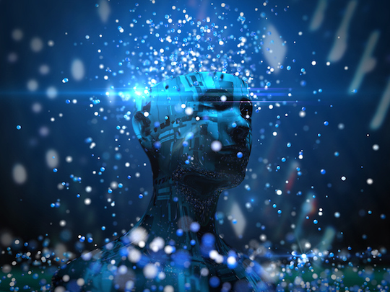
3. Cloud Services & Integrations
These are third-party services that enhance the calendar’s functionality.
Components:
Google Calendar API / Microsoft Outlook API
For syncing user events with external calendars.
Provides scheduling and reminder features.
AI-Based Suggestions (Optional)
Smart recommendations for event timings based on user habits
(via AI/ML models).
Cloud Hosting Services
AWS/GCP/Heroku for deploying the backend.
Tools Used: Google Calendar API, Firebase.
This Photo by Unknown Author is licensed under CC BY

Slide 8
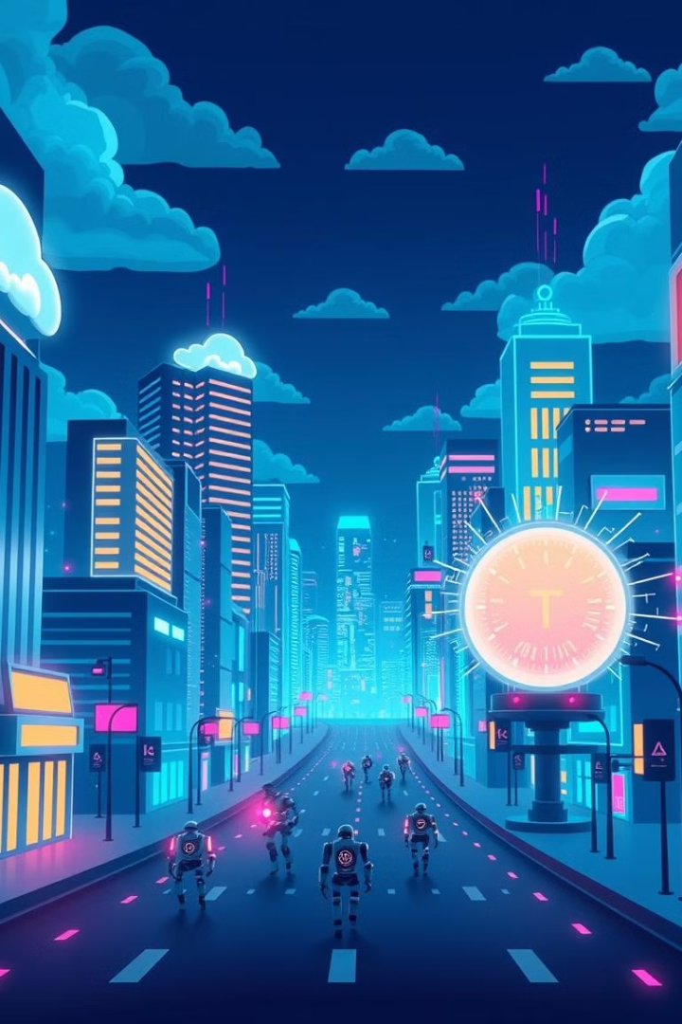

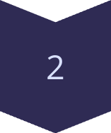
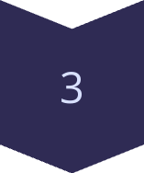
Under the Hood: Technologies Driving Smart Calendars (IoT, AI, Cloud)
IoT
Enables device communication and automation.
AI
Powers smart predictions and task optimization.
Cloud
Provides scalable data storage and syncing.

Slide 9
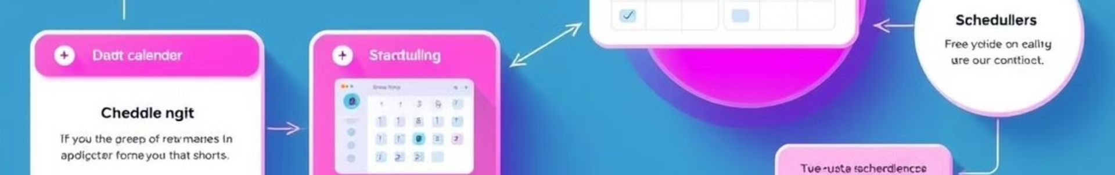
How It Works: A Step-by-Step Process
Data Collection
1
IoT devices gather user data.
2
Data Analysis
AI algorithms process and analyze data.
Task Scheduling
3
Smart calendar schedules tasks and events.
4
User Feedback
Calendar adapts based on user interactions.

Slide 10
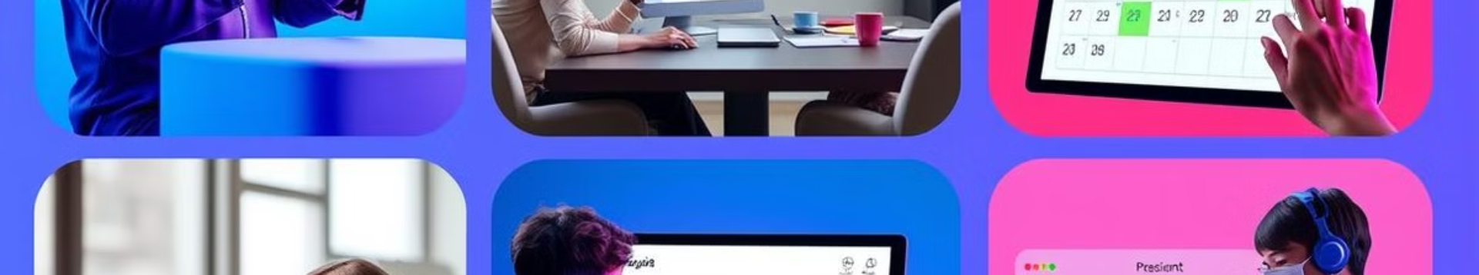
Real-World Applications: From Personal Use to Business Optimization
Personal Scheduling
Business Meetings
Automated reminders and task prioritization.
Smart scheduling of meetings and resources.
Education
Healthcare
Class scheduling and academic task management.
Appointment scheduling and patient management.

Slide 11



Case Study: Smart Calendar Integration in a University Setting
2
Course Scheduling
1
Resource Management
Student Activities
3
A university uses smart calendars for effective resource management. The calendar also supports efficient course scheduling. It helps facilitate seamless student activity planning.

Slide 12
The Future of Smart Calendars: Trends and Innovations
Enhanced AI
1
More accurate predictions.
IoT Expansion
2
Broader device integration.
Customization
3
Personalized user experiences.

Slide 13

Implementing Your Own Smart Scheduling Solutions
Next steps involve planning and testing.
.
Thank you.

